Slide 1


Successful and Profitable Product Launch on Kickstarter
Aidan Au
10/25/2021

Slide 2
Agenda
Successful and Profitable Product Launch on Kickstarter
Background - Why Do People Go To KickStarter? 3
Pros and Cons of Launching a Product on Kickstarter 5
Notable Projects On KickStarter 6
Business Problem / Research Question 11
Data Set Characteristics 14
Analysis – Key Results & Recommendation 15
Future Work / Next Steps & Improvements 27
My GitHub Link to the Project

Slide 3
Background Why Do People Hang Out On KickStarter?
Business Owners/ Creators
Bring a product idea to life - from developing a prototype to selling
Validate a proof of concept or a viable idea from the market
Sell FIRST then build instead of building first then selling second
Get startup cash/initial funding WITHOUT giving up equity/taking a loan
Paying Customers/Backers
Pay to support creators who will bring new products to life and to save from future retail price
To have early access to new or innovative products before customers outside of Kickstarter

Slide 4
Life of a Business Owner/Creator on Kickstarter A tale of two outcomes
Your journey starts here
Start a project on Kickstarter
Funding Goal: e.g. $50,000
Duration: e.g. 30 days
Fail to hit your funding goal
Hit your funding goal
Receive $0 even if your funding goal is not met
Get all the money raised minus a 10% fee roughly

Slide 5
Pros and Cons of Launching a Product on Kickstarter Risks and Rewards
Advantages
Get startup cash/initial funding without giving out equity/taking a loan
Solve cash flow problem - pre-selling products BEFORE available and taking pre-orders; Flip the timeline - generate pre-revenue before even having a product to sell or paying for inventories
You can raise more money even if your funding goal is met (over-funded)
A global community of millions of repeat customers/backers actively browse Kickstarter and ready to pay to support projects (which potentially lower the customer acquisition costs)
Alternative funding vs traditional financing such as loans from friends and families, (high-interest) SBA loans from banks, angel investors/venture capital, or Shark Tanks/Dragons' Den
Customer research - getting feedback for earlier version of your products
[Win-win] Not obligated to develop a product or pay Kickstarter a fee if your funding goal is not met; Customers/backers of a project don’t get charged until the project has met its funding goal/the project is successful.
Disadvantages
Hurt chances of getting subsequent funding from investors if a project failed. What will The Verge, CNET, engadget, or TechCrunch write about your failed campaigns?
All-or-nothing funding model (Zero funding if you fail to hit your funding goal)
Not all projects/products do well on Kickstarter - choose wisely
Customers may be deterred by projects with a longer duration; A shorter duration may lead to a failed and under-funded project

Slide 6
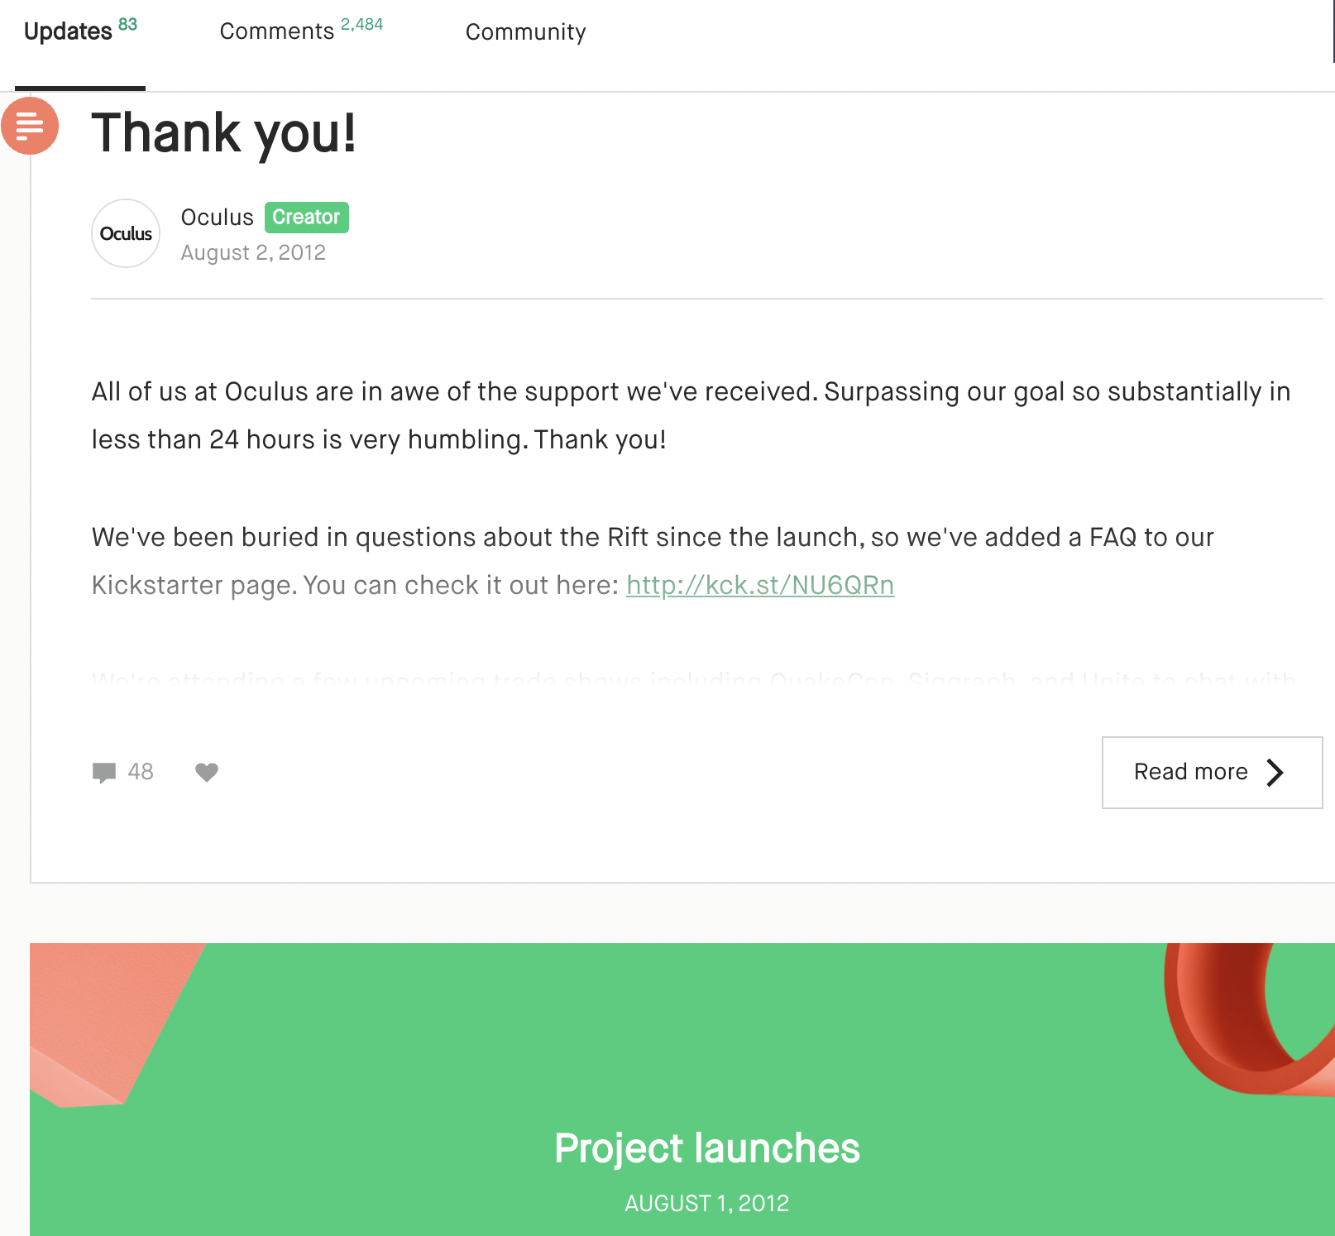
Oculus Launched A Product on KickStarter in 2012 (Before They Were Acquired by FB in 2014)

Slide 7
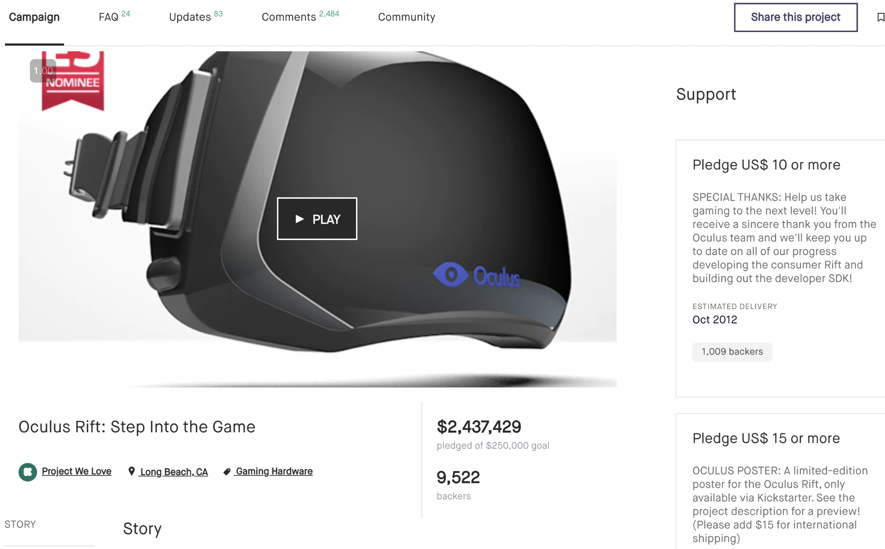
Oculus Surpassed Its Goal of $250k in Less Than 24 Hours
Backers

Slide 8
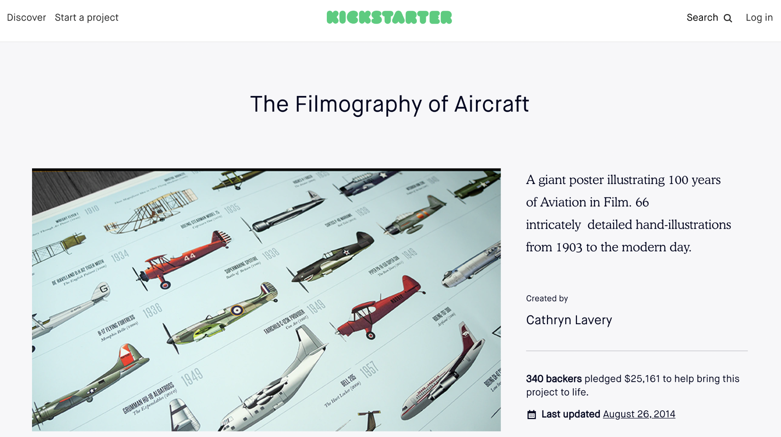
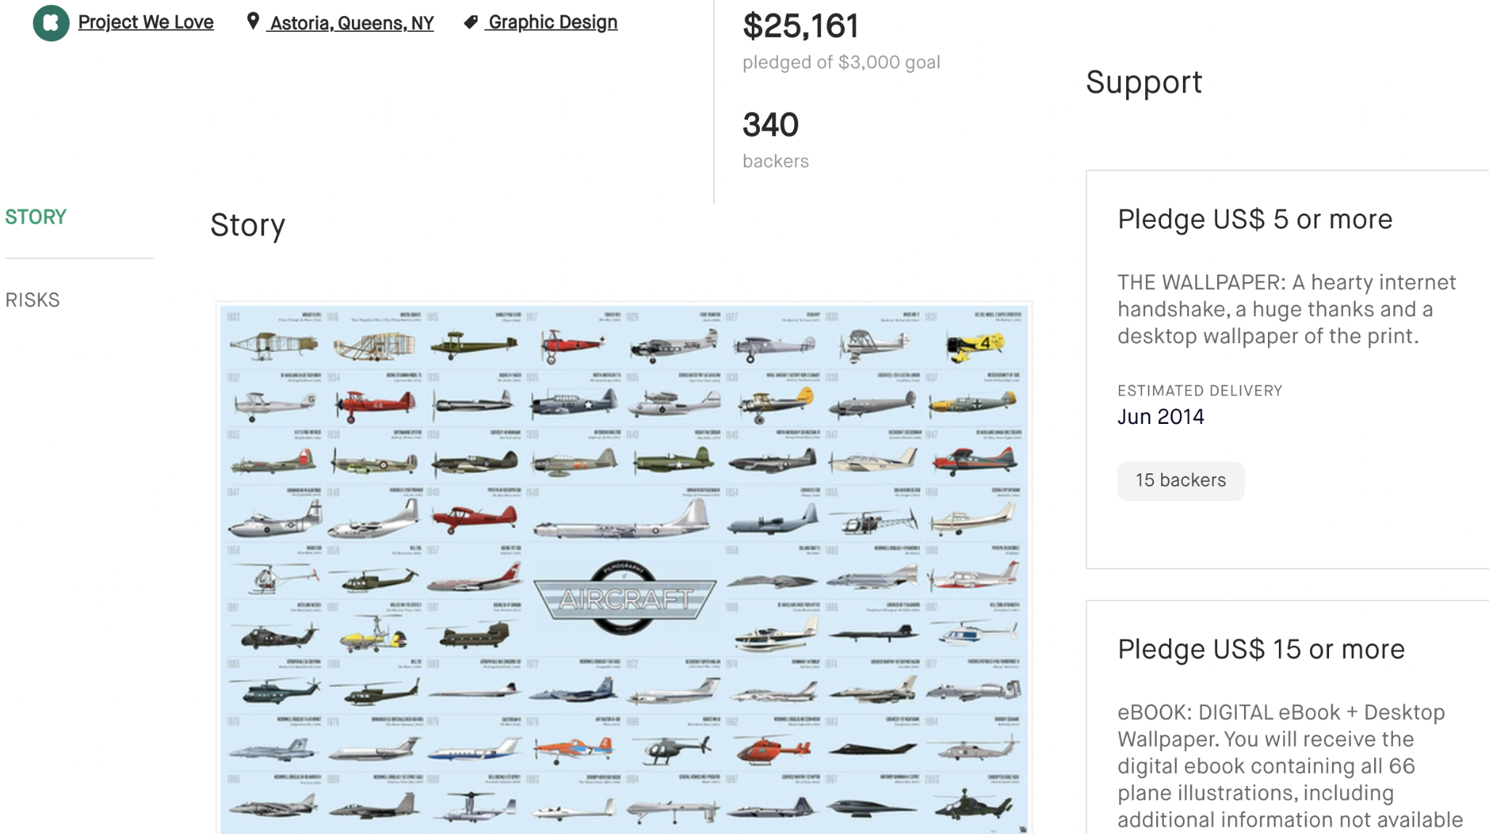
A Coffee Table Book by Cathryn Lavery

Slide 9
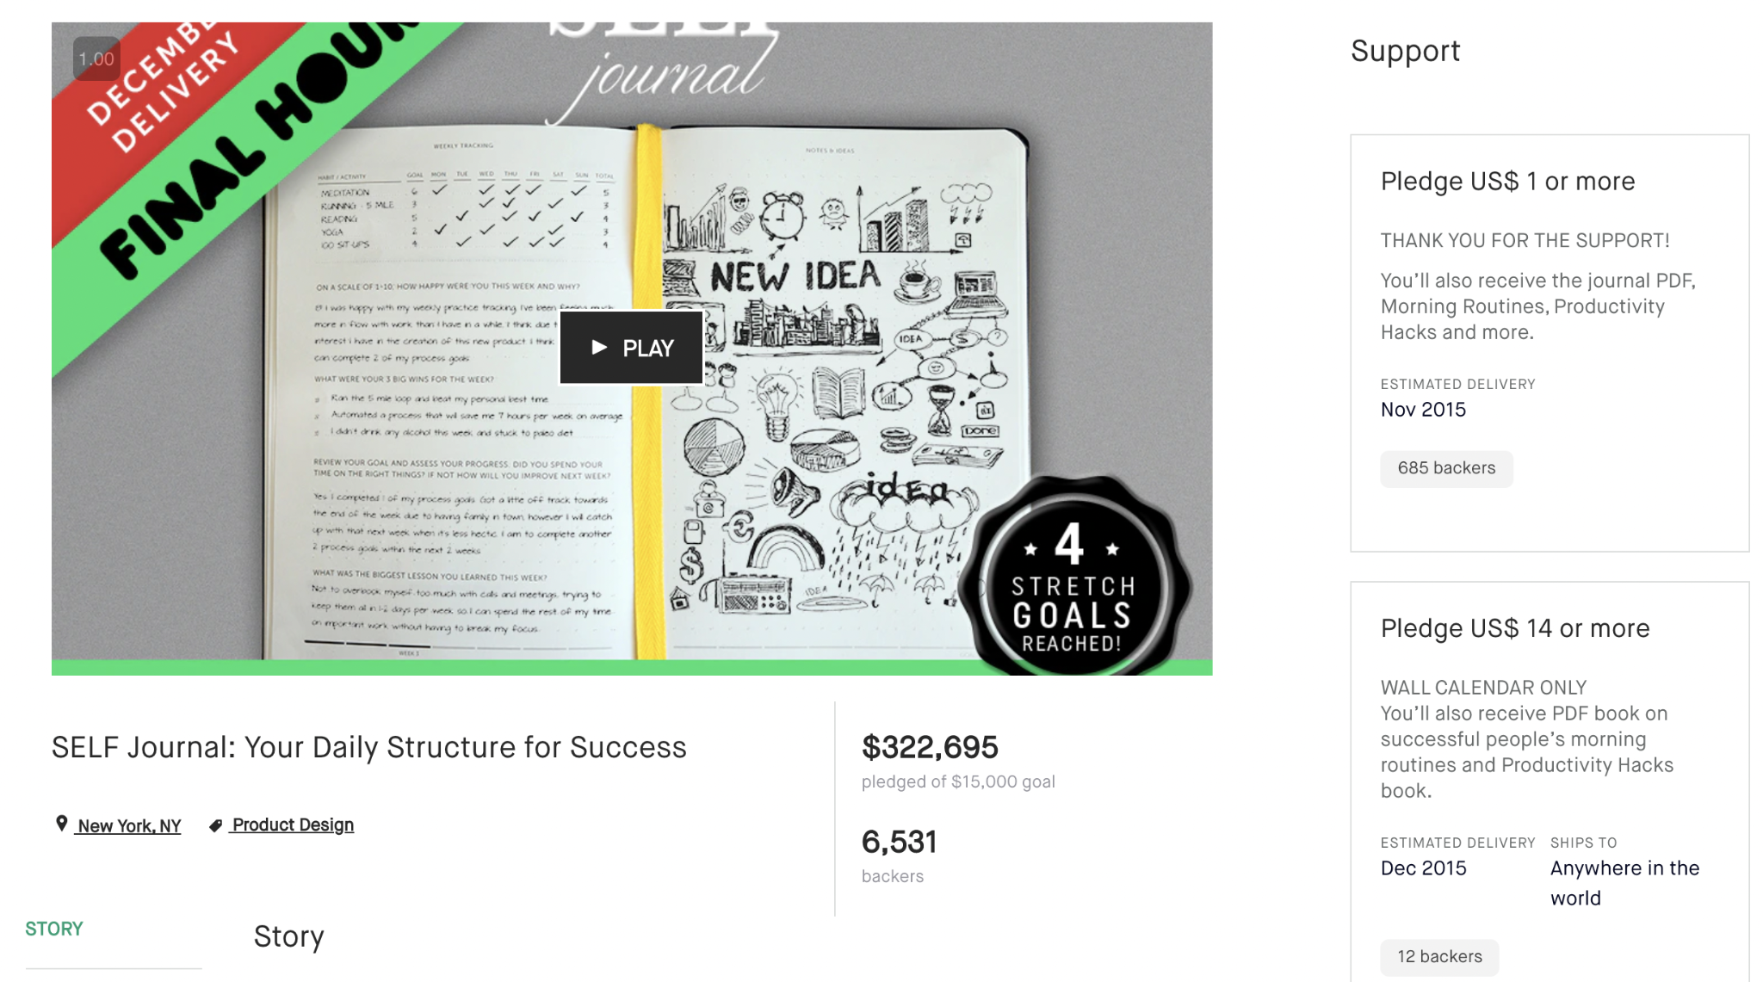
SELF Journal by Cathryn Lavery of Best Self Co.

Slide 10

SELF Journal by Cathryn Lavery of Best Self Co.

Slide 11
Overall Success Rate on Kickstarter
Success Rate: 39.18%
Unsuccessful Rate: 60.82%
Source: Stats page on Kickstarter.com, Last updated: Sat, October 16 2021 12:12 PM EDT

Slide 12
Success Metrics
1. Success Rate/Failure Rate
2. Amount Raised for the Projects (i.e. Amount Pledged by the Backers)

Slide 13
Business Problem / Research Questions
Question 1. How do you pick a winning category to successfully fund your projects on Kickstarter, and what to avoid?
Question 2. Does the length/duration of a project play a role in its success/failure?
Question 3. How can you raise as much money as possible?

Slide 14
Data Set Characteristics Follow The Data
Dataset Information
Dataset Visualizations
Made Available by Mickaël Mouillé on Kaggle
378,657 projects/data points
77% of data points were projects launched in the US, which were used in the upcoming data analysis
No duplicates
15 Main Categories of projects
Other columns include
the number of backers,
amount of money pledged by supporters (the amount of money a project raised),
goal amounts,
launch dates and deadlines,
state: successful, failed, canceled, suspended or live
Kickstarter was founded on April 28, 2009. Data from 2009 to January 2018 were used in the analysis.

Slide 15
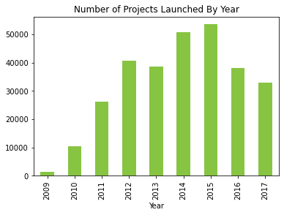
Growth On Kickstarter Since Founded

Slide 16
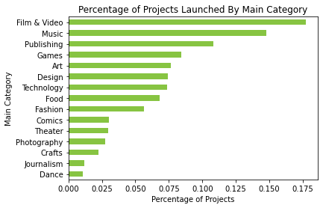
Common Project Categories On Kickstarter

Slide 17
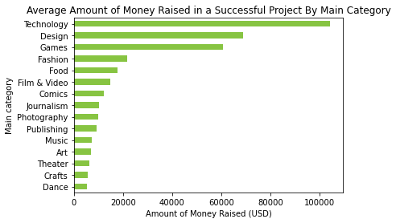
Amount of Money Raised Vary by Categories

Slide 18
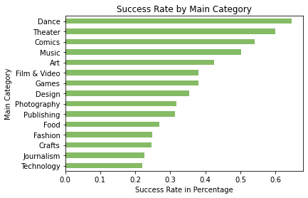
Question 1. How to pick a winning main category to successfully fund your projects on Kickstarter, and what to avoid? Projects/Products that have typically succeeded/failed

Slide 19
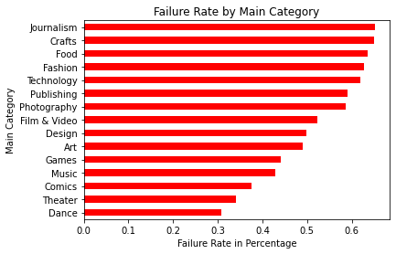
There’re Winners And Losers in Every Main Category

Slide 20
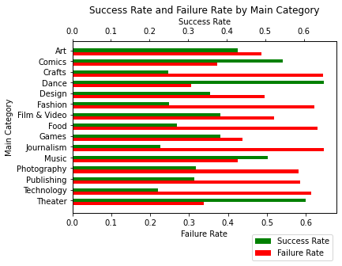

Slide 21
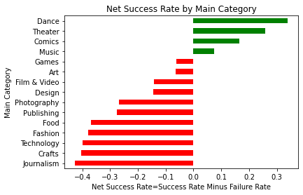
Go After the Categories That Have More Winners Than Losers. There’re Still Money To Be Made On Kickstarter

Slide 22
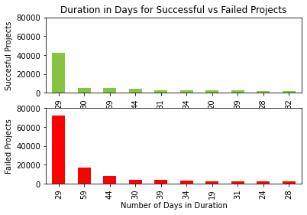
Question 2. Does the length/duration of a project play a role in its success/failure?

Slide 23
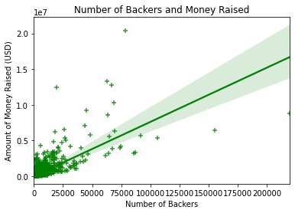
Question 3. How can you raise as much money as possible?

Slide 24
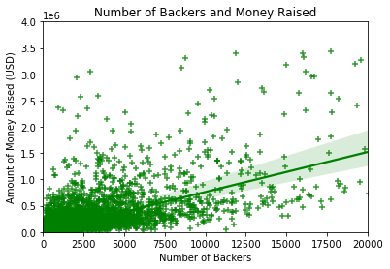
Looking Closely At The Bottom Left Part Of The Last Chart
Notes:
Look at the 12,500 to 15k back mark, not gonna get 0 dollar
look at the 3M-3.5M mark. at least 2.5k backers
Projects with a higher number of backers tend to have a raise more money

Slide 25
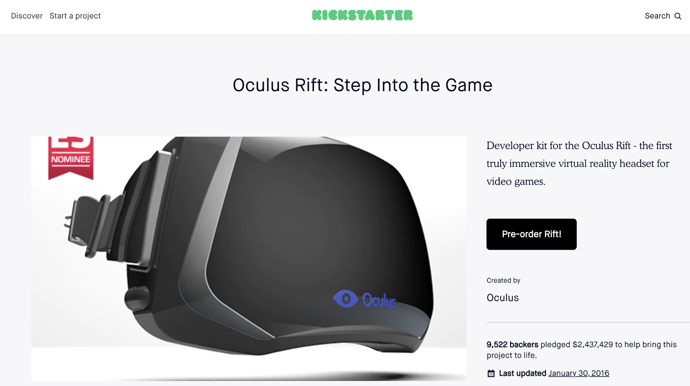
There is a high correlation between the number of backers and the amount pledged by the backers (i.e. the amount raised for the projects)
Positive Correlation/ Positive Relationship
Notes:
correlation is not necessarily casualation
3rd element/competent
going the same direction

Slide 26
Recommendation: Always Include A Reward Level Of $1
To get an easy yes from a backer and, and hence to increase the number of backers
Your reward can be, for example, a personalized thank-you video from the Founder(s)
The more money you raise, the more likely your projects are going to succeed

Slide 27
Next Steps & Improvements
Project/Approach Improvements
Lessons learned
Use more recently web-scraped data (scraped once a month)
Build a model to predict the success of a project (Target Variable); Build the model for production ready to be deployed
Future data collection/feature engineering: Explore other relationship/correlation with features such as the number of comments, updates, and reward levels, etc. (More Predictor Variables)
Expand the project but with more data from other crowdfunding websites such as IndieGoGo, GoFundMe or Product Hunt.
Talk to domain experts in Kickstarter and crowdfunding
Why I did not web-scrape or use web-scraped data --- Ideas are a dime a dozen. Execution is everything. Ideas are Only as Good as the Execution
Took additional data visualization courses on using subplots and overlaying two plots into one

